Slide 1
Game Designer
Session 02

Slide 2
OUTLINE
Play Mechanics
Action and Interface
Game Systems
Prototyping and Playtesting Cycles
Playtesting

Slide 3
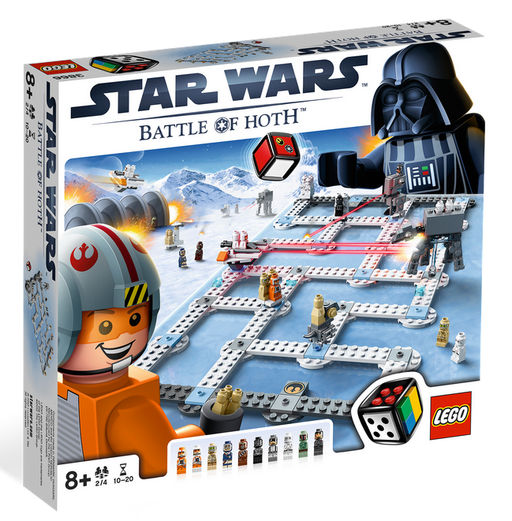
Show video: https://www.youtube.com/watch?v=l0QGaV-b4cw

Slide 4
PLAY MECHANICS
A play mechanic is formed when the player applies game actions to game elements.
interactions that produce a meaningful result
Mechanics don’t have to be critical enterprises, but they do need to serve the overall purpose of play in some way
As a note, keep in mind one running thesis for all design:
If the feature does not improve the game, it should not exist in the game.

Slide 5
PLAY MECHANICS
Player Arrangements

Slide 6
PLAY MECHANICS
Player Arrangements
Single player—player contends with the game system.
Player vs. player—two players contend with each other.
Multilateral competition—three or more players contend with each other.
Team competition—two groups compete with each other.

Slide 7
PLAY MECHANICS
Player Arrangements
Multilateral team competition—three or more groups compete.
Unilateral competition—two or more players compete with one player.
Multiple individual vs. game—multiple players compete against the system.
Cooperative—two or more cooperate against the game system.

Slide 8
PLAY MECHANICS
Core Mechanics
In every game there is one or more core mechanics
distinctive and fundamental sequences of actions and results that players repeat throughout the game to advance
Not all repeatable mechanics are considered to be core
Ex: action game, core mechanics might be based on movement and combat.
Ex: farming game, tilling and sowing; a social networking game might have trading and stealing for core mechanics

Slide 9
PLAY MECHANICS
Local Emergent Gameplay
As second-order mechanics results from the combined use of other mechanics and systems.
When second-order mechanics are simple exploitations of game systems, they can often be viewed negatively as exploits, even when they don’t violate the game premise.
Ex: (next slide)

Slide 10
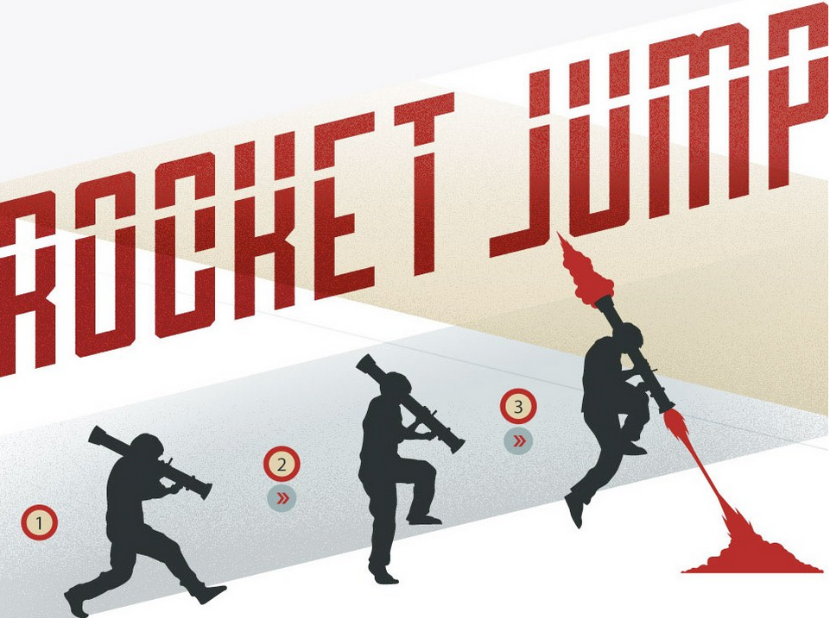

Slide 11
PLAY MECHANICS
Fighting
used to be the primary mechanic in most games, but this has changed gradually over time
especially with the rise of online casual games.

Slide 12
PLAY MECHANICS
Inventories and Collections
How large will the inventory need to be? Can it be smaller?
How will objects be stored? Removed?
How will they be retrieved? Used?
Will they need to be organized? Sorted?

Slide 13
PLAY MECHANICS
Rewards (and Punishment)
Offer valuable rewards for valuable achievement.
Keep rewards coming in cycles averaging less than 15 minutes.
Use rewards to establish and emphasize the game’s rhythm.
Allow players to chain rewards together, increasing the value.
Create rewards for each experience you want to support.
Use collections of small rewards that lead to huge rewards.

Slide 14
PLAY MECHANICS
Puzzles
Puzzles are problems.
Ex: game:
Puzzles have a solution, a right answer

Slide 15
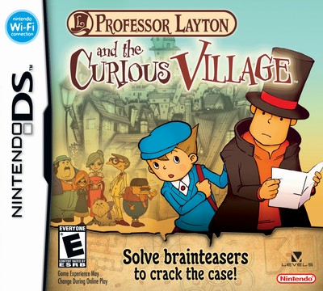
Play video at: https://www.youtube.com/watch?v=-xXiI_QY87E

Slide 16
PLAY MECHANICS
Information
What kind of information is this?
What is the value of this information to players?
What are the benefits of sharing it with them?
What are the benefits of keeping it from them?
Ex: boardgame Carcassonne (next slide)

Slide 18
PLAY MECHANICS
Enhancing Uncertainty
if you discover that things are too predictable, resist the immediate temptation of quick fixes like “adding randomness.”
If you do decide to introduce randomness, look for parts of your game systems where the unsystematic behavior won’t be too obvious or out of place.

Slide 19
PLAY MECHANICS
Choices and Outcomes
Choice – the act of choosing- lies close to the root of how we understand our game experiences.
A choice may be known as a question asked of the player.
Through the course of a game, player choices create imperatives for actions, which lead to outcomes.

Slide 20
PLAY MECHANICS
Keep It Simpler
Careless complexity causes us to spend more time trying to get mechanics under control than we ever spent inventing them in the first place
Each option that you offer players comes at a cost. When they make a choice, they are getting something they want, but it often comes at the cost of other things that they might have wanted. Studies show that people tend to weigh their satisfaction with a past decision against the

Slide 21
Actions
Goals
“Kobe Bryant Doesn’t Dribble”
Real World to Game World

Slide 22
Interface

Slide 23
Interface
Controls

Slide 24
Interface
Feedback
What should the player never know?
What should the player always know?
What should the player sometimes know?
When should he know it?
How should he know it?
Will he need to be alerted or reminded?

Slide 25
Interface
Constraints and Context Sensitivity
helping make the player’s goals clearer.
Too many available choices lead to confusion.
Context-sensitive controls allow players to do specific actions in specific circumstances

Slide 26
Interface
Viewpoint
Orthogonal Views
First and Third Person

Slide 27
Interface
Graphical Interface

Slide 28
Interface
Graphical Interface

Slide 29
Interface
Audio

Slide 30
Game Systems
Dynamics of Systems
Feedback Loops
Simulation versus Emulation
Variable Difficulty
Save/Load Systems
Resources and Economies

Slide 31
Prototyping and Playtesting Cycles
the best way to know if a design is good is to play it as soon as possible.
Physical prototypes are games you make from paper, cards, chips, tokens, dice, and other common items
Software prototypes are implemented in code. These are the prototypes that, once in production, you are most likely to make use of regularly.

Slide 32
Playtesting
Playtesting is finding problems from the user’s perspective.
Can the players use the controls? Do they understand them?
Is the GUI clear? Menus navigable?
Can the levels be completed? With how much effort?
Can the needed skills be learned? In how long?
Are they entertained? In what ways?

